Slide 1

IA- 32 Architecture
Richard Eckert
Anthony Marino
Matt Morrison
Steve Sonntag

Slide 2
IA-32 Overview
IA-32 Overview
  Pentium 4 / Netburst µArchitecture
  SSE2
Hyper Pipeline
  Overview
  Branch Prediction
Execution Types
  Rapid Execution Engine
  Advanced Dynamic Execution
Memory Management
  Segmentation
  Paging
  Virtual Memory
Address Modes / Instruction Format
  Address Translation
Cache
  Levels of Cache (L1 & L2) / Execution Trace Cache
  Instruction Decoder
  System Bus
Register Files
  Enhanced Floating Point & Multi-Media Unit
Summary / Conclusion

Slide 3
IA-32 Background
Traced to 1969
  Intel 4004
P4
  1st IA-32 processor based on Intel Netburst microprocessor.
Netburst
  Allows
    Higher Performance Levels
    Performance at Higher Clock Speeds
Compatible with existing applications and operating systems
  Written to run on Intel IA-32 architecture Processors

Slide 4
1st Implementation of Intel Netburst µArchitecture
Rapid Execution Engine
Hyper Pipelined Technology
Advanced Dynamic Execution
Innovative Cache Subsystem
Streaming SIMD Extensions 2 (SSE2)
400 MHz System Bus

Slide 5
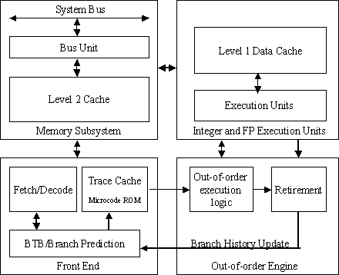
Netburst µArchitecture

Slide 6
SSE2
Internet Streaming SIMD Extensions 2 (SSE2)
  What is it?
  What does it do?
  How is this helpful?

Slide 7
IA-32 Overview
IA-32 Overview
  Pentium 4 / Netburst µArchitecture
  SSE2
Hyper Pipeline
  Overview
  Branch Prediction
Execution Types
  Rapid Execution Engine
  Advanced Dynamic Execution
Memory Management
  Segmentation
  Paging
  Virtual Memory
Address Modes / Instruction Format
  Address Translation
Cache
  Levels of Cache (L1 & L2) / Execution Trace Cache
  Instruction Decoder
  System Bus
Register Files
  Enhanced Floating Point & Multi-Media Unit
Summary / Conclusion

Slide 8
Hyper Pipelined
What is hyper pipeline technology?
  Deeper pipeline
  Fewer gates per pipeline stage
What are the benefits of hyper pipeline?
  Increased clock rate
  Increased performance

Slide 9
Netburst™ vs. P6
1
Fetch
2
Fetch
3
Decode
4
Decode
5
Decode
6
Rename
7
ROB Rd
8
Rdy/Sch
9
Dispatch
10
Exec
Typical P6 Pipeline
1 2
TC Nxt IP
3 4
TC Fetch
5
Drive
6
Alloc
7 8
Rename
9
Que
10
Sch
11
Sch
12
Sch
13
Disp
14
Disp
15
RF
16
RF
17
Ex
18
Flgs
19
BrCk
20
Drive
Typical Pentium 4 Pipeline

Slide 10
1 2
TC Nxt IP
3 4
TC Fetch
5
Drive
6
Alloc
7 8
Rename
9
Que
10
Sch
11
Sch
12
Sch
13
Disp
14
Disp
15
RF
16
RF
17
Ex
18
Flgs
19
BrCk
20
Drive
3.2 GB/s System Interface
L2 Cache and Control
Store
AGU
L1 D-Cache and D-TLB
BTB
Schedulers
Integer RF
Load
AGU
BTB & I-TLB
Decoder
Trace Cache
Rename/Alloc
μop Queues
ALU
ALU
ALU
ALU
FP RF
FP move
FP store
μCode
ROM
Fmul
Fadd
MMX
SSE

Slide 11
Netburst µArchitecture

Slide 12
Branch Prediction
Centerpiece of dynamic execution
  Delivers high performance in pipelined μ- architecture
Allows continuous fetching and execution
  Predicts next instruction address
Branch is predictable within 4 or less iterations
Branch Prediction decreases the amount of instructions that would normally be flushed from pipeline

Slide 13
Examples
If (a == 5)
a = 7;
Else
a = 5;
L1: lpcnt++;
If ((lpcnt % 5)== 0)
printf (“ Loop count is divisible by 5\n”);
Predictable
Not Predictable

Slide 14
IA-32 Overview
IA-32 Overview
  Pentium 4 / Netburst µArchitecture
  SSE2
Hyper Pipeline
  Overview
  Branch Prediction
Execution Types
  Rapid Execution Engine
  Advanced Dynamic Execution
Memory Management
  Segmentation
  Paging
  Virtual Memory
Address Modes / Instruction Format
  Address Translation
Cache
  Levels of Cache (L1 & L2) / Execution Trace Cache
  Instruction Decoder
  System Bus
Register Files
  Enhanced Floating Point & Multi-Media Unit
Summary / Conclusion

Slide 15
Rapid Execution Engine
Contains 2 ALU’s
  Twice core processor frequency
Allows basic integer instructions to execute in ½ a clock cycle
Up to 126 instructions, 48 load, and 24 stores can be in flight at the same time
Example
  Rapid Execution Engine on a 1.50 GHz P4 Processor runs at _________Hz?

Slide 16
`
Out-of-Order
Execution
Logic
Retirement
Logic
Branch History Update

Slide 17
Advanced Dynamic Execution
Out-of-Order Engine
  Reorders Instructions
  Executes as input operands are ready
  ALU’s kept busy
Reports Branch History Information
Increases overall speed

Slide 18
IA-32 Overview
IA-32 Overview
  Pentium 4 / Netburst µArchitecture
  SSE2
Hyper Pipeline
  Overview
  Branch Prediction
Execution Types
  Rapid Execution Engine
  Advanced Dynamic Execution
Memory Management
  Paging
  Virtual Memory
  Segmentation
Address Modes / Instruction Format
  Address Translation
Cache
  Levels of Cache (L1 & L2) / Execution Trace Cache
  Instruction Decoder
  System Bus
Register Files
  Enhanced Floating Point & Multi-Media Unit
Summary / Conclusion

Slide 19
Memory Management
Management Facilities divided into two parts:
Segmentation - isolates individual processes so that multiple programs can on same processor without interfering w/each other.
Demand Paging - provides a mechanism for implementing a virtual-memory that is much larger than the actual memory, seemingly infinite.

Slide 20

Memory Management
Address Translation
Ex: Comp. Arch. I
Instruction Address
Instruction
Control Word
Instruction Decoder
IA-32
Memory
(Virtual Address)
Control Word
Segmentation
& Paging
Logical Address
Physical Address
Memory

Slide 21
Modes of Operation
Concentration on:
Protected mode - Native operating mode of the processor. All features available, providing highest performance and capability.
- Must use segmentation, paging optional.
Other modes:
Real-address mode - 8086 processor programming environment
System management mode (SMM) - Standard arch. feature in all later IA-32 processors. Power management, OEM differentiation features
Virtual-8086 mode - used while in protected mode, allows processor to execute 8086 software in a protected, multitasked environment.

Slide 22
Paging
Subdivide memory into small fixed-size “chunks” called frames or page frames
Divide programs into same sized chunks, called pages
Loading a program in memory requires the allocation of the required number of pages
Limits wasted memory to a fraction of the last page
Page frames used in loading process need not be contiguous
- Each program has a page table associated with it that maps each program page to a memory page frame

Slide 23
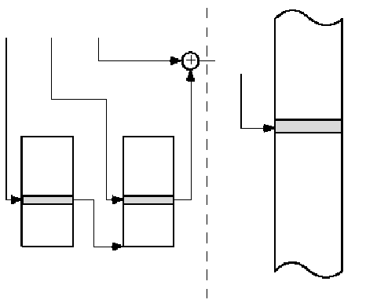
IA-32: 2 - Level Paging
Linear Address
Logical Address
Segmentation
Dir Page Offset
Physical Address
Control Word
Virtual Memory:
Only program pages required for execution of the program are actually loaded
Only a few pages of any one program might be in memory at a time
Possible to run program consisting of more pages than can fit in memory
“Demand” Paging
Page Directory
Page Table
Paging
Main Memory

Slide 24
Segmentation
Programmer subdivides the program into logical units called segments
- Programs subdivided by function
- Data array items grouped together as a unit
Paging - invisible to programmer, Segmentation - usually visible to programmer
- Convenience for organizing programs and data, and a means for associating access and usage rights with instructions and data
- Sharing, segment could be addressed by other processes, ex: table of data
- Dynamic size, growing data structure

Slide 25
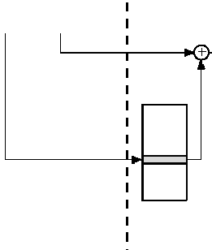
Address Translation
Segment Offset
Linear Address
Dir Page Offset
Physical Address
Control Word
Segment Table
Index TI RPL
Index: The number of the segment. Serves as an index to the segment Table.
TI: (one bit) Table indicator indicates either global or local segment table to be used for translation
RPL: (two bits) Requested privilege level, 0=high privilege, 3 = low
Page Directory
Page Table
Paging
Main Memory

Slide 26
IA-32 Overview
IA-32 Overview
  Pentium 4 / Netburst µArchitecture
  SSE2
Hyper Pipeline
  Overview
  Branch Prediction
Execution Types
  Rapid Execution Engine
  Advanced Dynamic Execution
Memory Management
  Paging
  Virtual Memory
  Segmentation
Address Modes / Instruction Format
  Address Translation
Cache
  Levels of Cache (L1 & L2) / Execution Trace Cache
  Instruction Decoder
  System Bus
Register Files
  Enhanced Floating Point & Multi-Media Unit
Summary / Conclusion

Slide 27
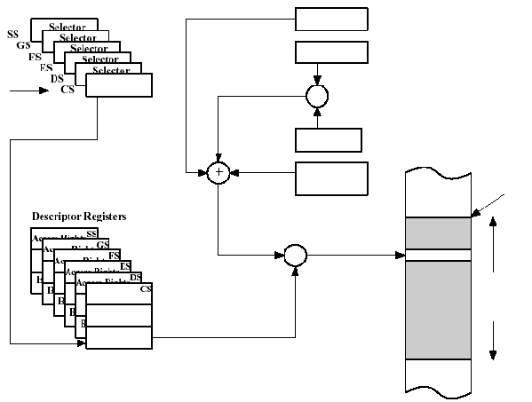
Addressing Modes
- Determine technique for offset generation
Segment Offset
Base Register
Index Register
x
Scale 1, 2, 4, or 8
+
Displacement (in instruction; 0, 8, or 32 bits)
Segment Base Address
Descriptor Registers
Effective Address (Offset)
+
Linear Address
Limit
Access Rights
Limit
Paging
(invisible to programmer)
Base Address
Main Memory

Slide 28
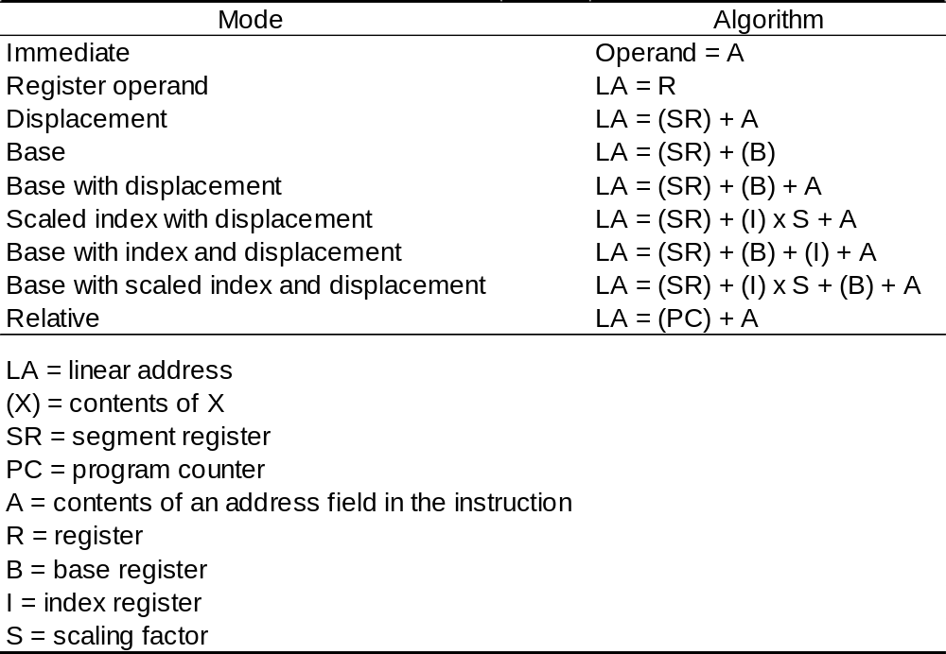
Addressing Modes

Slide 29
Ex: scaled index with displacement
Segment
Index Register
x
Scale 1, 2, 4, or 8
+
Displacement (in instruction; 0, 8, or 32 bits)
Segment Base Address
Descriptor Registers
Effective Address (Offset)
+
Linear Address
Limit
Access Rights
Limit
Base Address

Slide 30
Instruction Format
Bytes
0 or 1
0 or 1
0 or 1
0 or 1
Instruction Prefix
Segment Override
Operand Size Override
Address Size Override
Bytes
0 to 4
1 or 2
0 or 1
0 or 1
0, 1, 2, or 4
0, 1, 2, or 4
Instruction Prefixes
Opcode
Mod R/M
SIB
Displacement
Immediate
Mod
Reg/Opcode
R/M
Scale
Index
Base
7 6 5 4 3 2 1 0
7 6 5 4 3 2 1 0

Slide 31
IA-32 Overview
IA-32 Overview
  Pentium 4 / Netburst µArchitecture
  SSE2
Hyper Pipeline
  Overview
  Branch Prediction
Execution Types
  Rapid Execution Engine
  Advanced Dynamic Execution
Memory Management
  Segmentation
  Paging
  Virtual Memory
Address Modes / Instruction Format
  Address Translation
Cache
  Levels of Cache (L1 & L2) / Execution Trace Cache
  Instruction Decoder
  System Bus
Register Files
  Enhanced Floating Point & Multi-Media Unit
Summary / Conclusion

Slide 32
Cache Organization
Physical
Memory
System Bus
(External)
L2 Cache
Data Cache
Unit (L1)
Instruction
TLBs
Bus Interface Unit
Data TLBs
Instruction Decoder Trace Cache
Store Buffer

Slide 33
IA-32 Overview
IA-32 Overview
  Pentium 4 / Netburst µArchitecture
  SSE2
Hyper Pipeline
  Overview
  Branch Prediction
Execution Types
  Rapid Execution Engine
  Advanced Dynamic Execution
Memory Management
  Segmentation
  Paging
  Virtual Memory
Address Modes / Instruction Format
  Address Translation
Cache
  Levels of Cache (L1 & L2) / Execution Trace Cache
  Instruction Decoder
  System Bus
Register Files
  Enhanced Floating Point & Multi-Media Unit
Summary / Conclusion

Slide 34
Enhanced FP &
Multi-Media Unit
Expands Registers
  128-bit
  Adds One Additional Register
    Data Movement
Improves performance on applications
  Floating Point
  Multi-Media

